Slide 1
Beer Data Presentation - Resampling Task
Marcus Debnar – S2310454007 Stefan Habringer – S2310454013

Slide 2
Objective
Create additional data by sampling from the existing dataset
Skew resample to the left side of the distribution to simulate „bad“ additional data
Run Symbolic Regression and Clustering Algorithms on existing dataset, resample and combination

Slide 3
Data Preparation
41467_2024_46346_MOESM4_ESM.csv && 41467_2024_46346_MOESM7_ESM.csv
Merged Datasets – Overall Rating
Removed (>30) and Interpolated (<=30) NaN‘s Column values
Created Data Set for Partition with Overall Rating as Category (Not enough, Sufficient, Satisfying, Good, Very good)

Slide 4
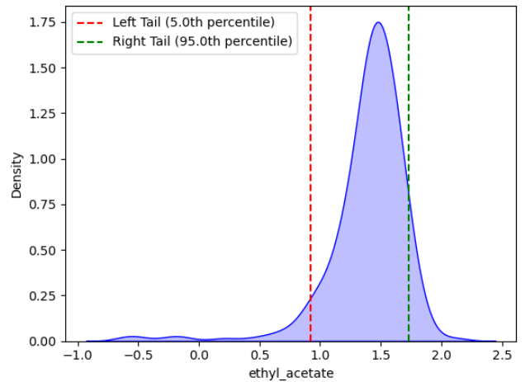
Resampling
Sample from left side distribution
Selected parameters:
Important parameters from the paper (ethyl_acetate,ethanol, ethyl_octanoate, ethyl.phenylacetate, protein, lactic_acid)
Correlataion induced (ethyl_acetate, kcalperc, isobutyl_acetate, H2S)

Slide 5
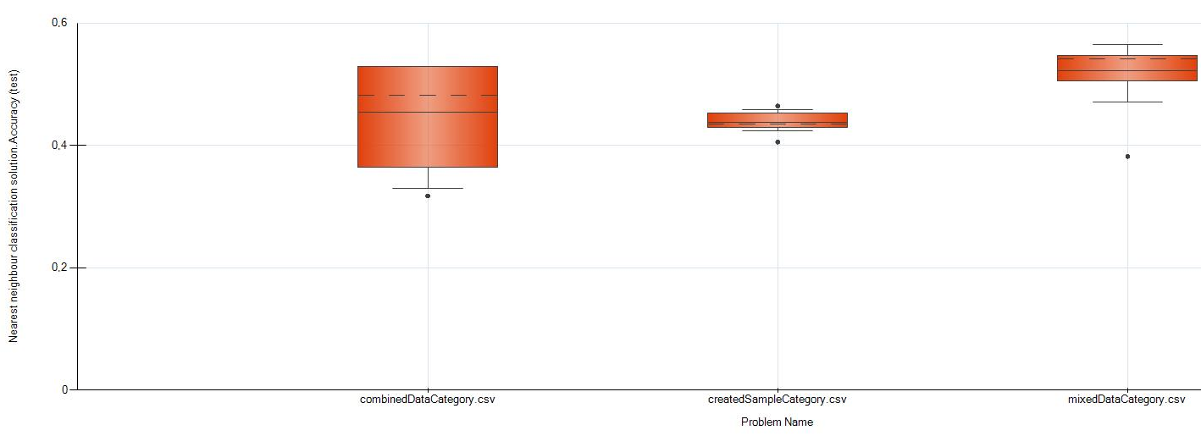
kNN Clustering
TODO

Slide 6
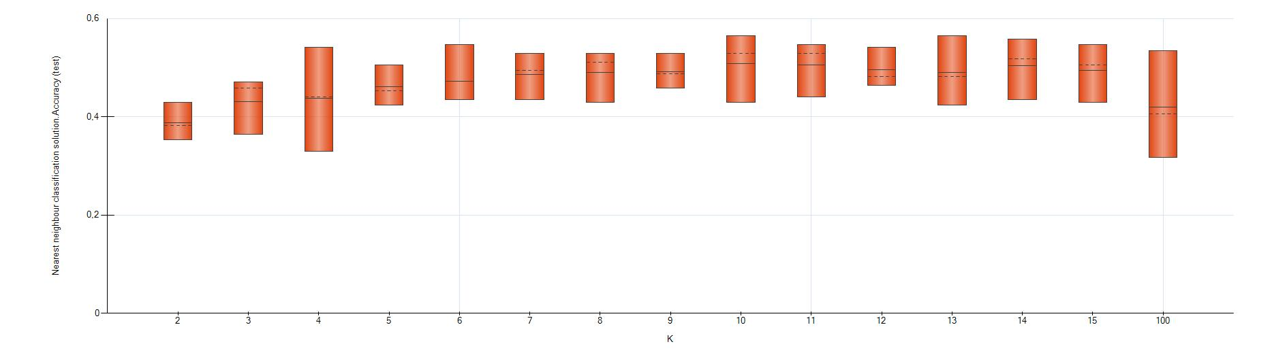
kNN Clustering
kNN – 2 – 15, 100 Clusters
Test Accuracy increases up to 10 Clusters and decreases subsequently
K13: Accuracy Test: 56.47 |Accuracy Training: 47.87
Max Gini Coefficient (difference to random guessing) K13: 0,297

Slide 7
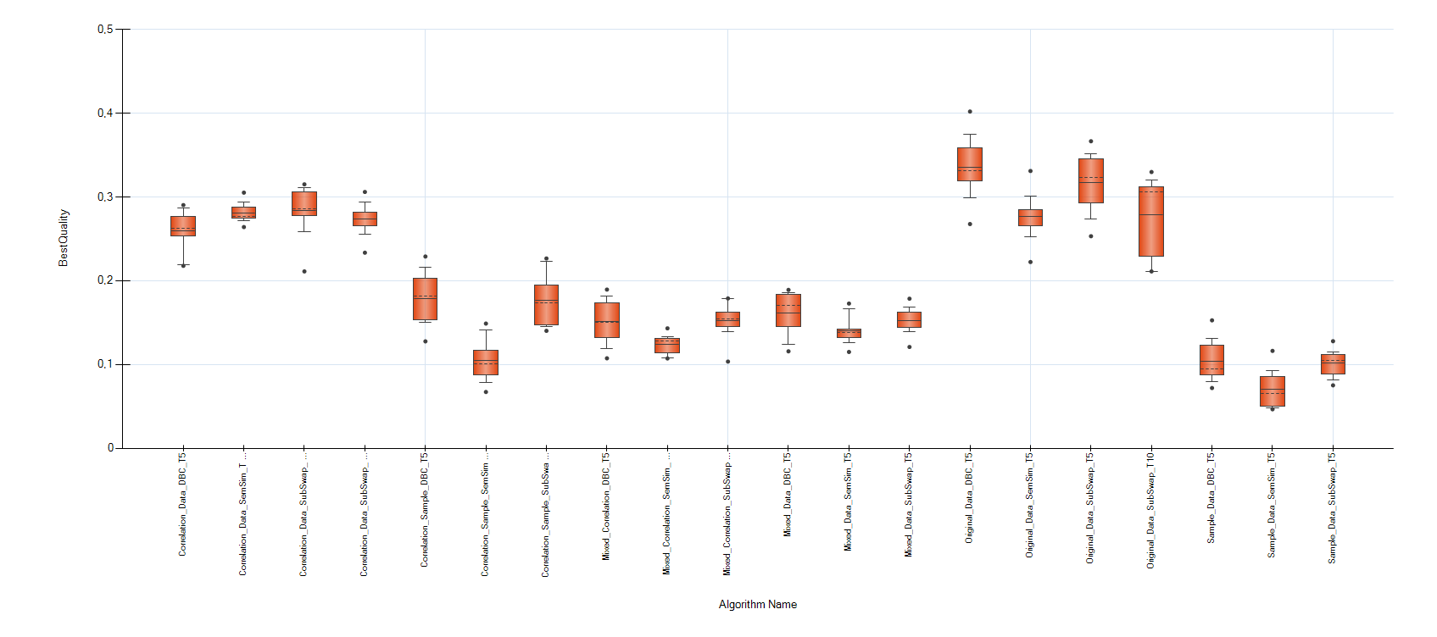
Symbolic Regression Task
Different Selectors and Crossovers for – original data – sample data – mixed data
Best results – original data with Deterministic Best Crossover – Tournament Selector Size 5

Slide 8
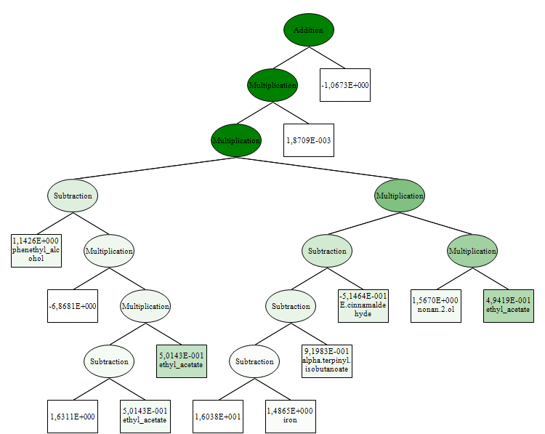
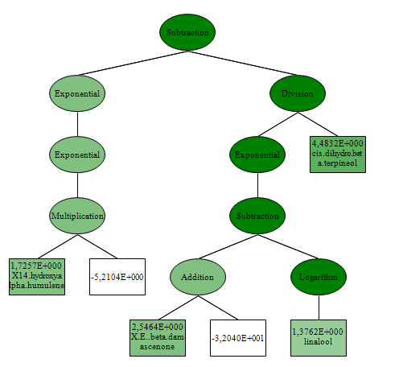
Symbolic Regression Task - Insights
Best results – original data with Deterministic Best Crossover – Tournament Selector Size 5
Original Data
Sample Data
Model Depth: 10 | Length: 27
R2 Test: 0,03 | R2 Training: 0,33
Model Depth: 8 | Length: 17
R2 Test: 0,01 | R2 Training: 0,08

Slide 9
Lessons Learned
Understanding the dataset is important and time consuming
Finding cluster size is not that easy
Larger clusters seem better
Weak Performance – overfitting symbolic regression and Clustering
Resampling alogorithm needs finetuning
Distribution

